Slide 1

SciCalc Industries
A Faster Tomorrow

Slide 2

Brainstorming Process
We considered users such as:
Nannies
Parents
Keeping an eye on kids
Scientists
Computer Science
Physics
Chemistry
Math
And… accepted any ideas as input
Notes:
First we targeted an audience that we thought could use help
Maximize the impact that our site would make

Slide 3

Brainstorming Process
We asked Physicists and Chemists:
What are the most annoying things you deal with
What would you like to see on a site that you don’t already see
What are some helpful features

Slide 4

Our Mission
Help fellow scientists with calculations
Provide a single place to do everything they might need
Share equations and findings with each other
Create a community
Physics
Chemistry
Fast access to any part of our site
Notes:
In and out as fast as possible

Slide 5
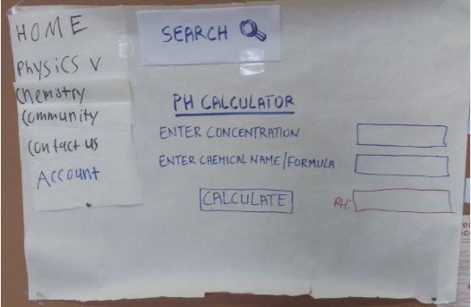
Paper Prototype
It is not apparent that the search bar will extend
when clicked on it
The label “PH CALCULATOR” looks like a clickable link
The output box for pH result should be moved underneath
the “CALCULATE” button
Needs icons to be added to different menus for easier
recognition

Slide 6
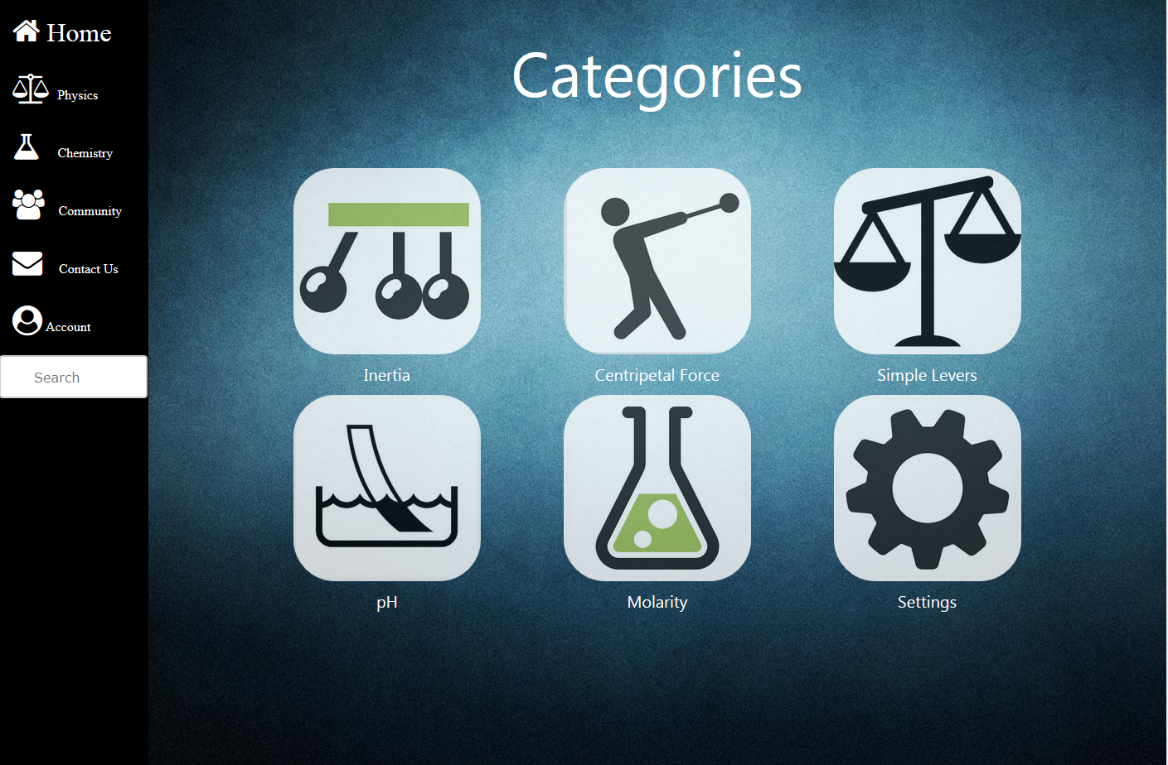
Computer prototype (1)
Home page
Icones getting messy when resizing the window
Simple levers button not working
Settings button not working
Background image getting messy when resizing
The window

Slide 7
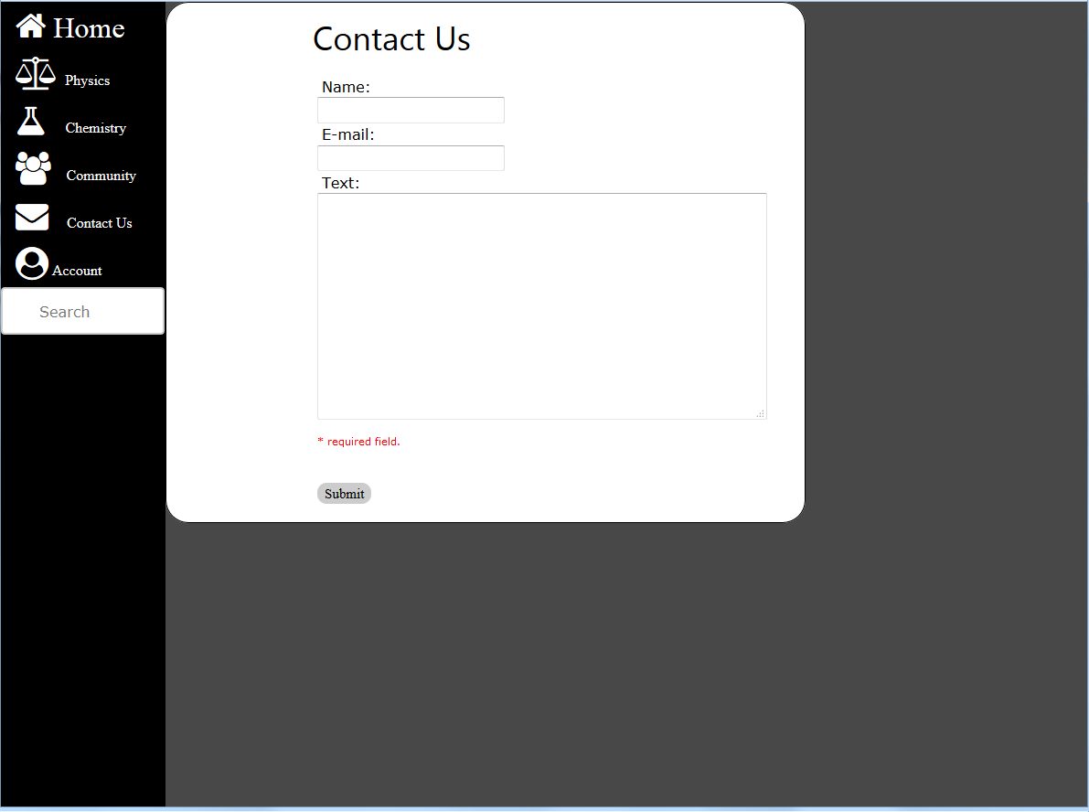
Computer Prototype (2)
Contact Us
Form needs to be centered
Choose a better color for background
Sidebar not consistent with other pages (space
Reduced between selection menus)

Slide 8
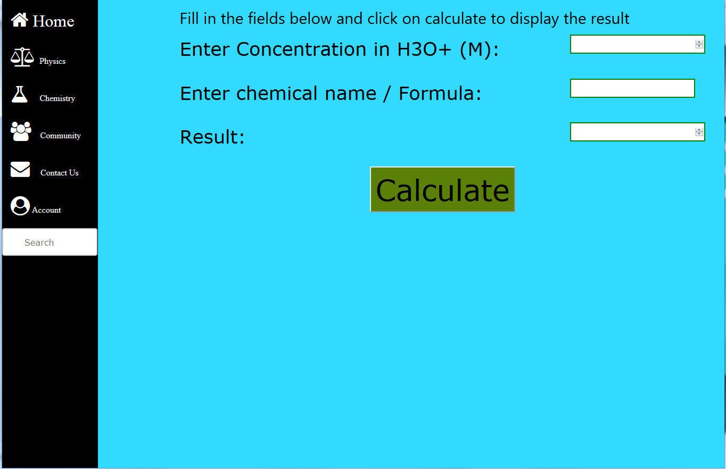
Computer Prototype (3)
pH Calculator
No label at the top of the page
Saturated color
Input fields not consistent in length
Boring font style
Large font size

Slide 9
The Final Product
Speed of calculation was achieved by using a minimal design
Color pallet was finalized in order relieve stress
The pleasing colors makes reading the table easy
No page is more than two clicks away from any other page
Uploading new equations is easy and can be done anywhere that equations are viewed
Notes:
Show how each calc page only contains that calculator reducing visual clutter
Each calc is also centered allowing for the eye to quickly find its way to what it needs
The assumption was that those who would use this site would be somewhat stressed due to long homework hours
Green was chosen in order to aid in reliveng this stress
The constant side bar allows easy accses of any part of the site
The usage of this sidebar means that two cliks whill get you from any part of the site to any other part
The color pallet also means that color blind users will still be able to navigate effectivly

Slide 10
Final Usability Results
Navigation tasks involved asking users to perform routine tasks
Users likes accessibility, large icons, hover tags, big buttons, and soft color pallet
Users found navigating the tables easy due to of hover row
Users never had to use the back button to find their way
Notes:
Tests included finding and using different calculators and then navigating to new functins

